Slide 1
Listed to Sold.
OUR PROCESS TO GET YOUR HOME SOLD.

Slide 2
Let’s get started.
If you want the best home-selling experience, you need a real estate agent who is not only a professional in the field, but who is a superb marketer, shrewd negotiator, and excellent communicator. When you hire me, you can take a deep breath knowing that your home is in the hands of an expert with a proven track record and who is trusted within the community.
Begin with the best to feel your best about your home.
Kimberly Dixon Dudley
REAL ESTATE BROKER
5151 Katy Fw #210 Hou,Tx 77007 | 713-357-1616| Kim@klptx.com

Slide 3
THE BROKERAGE
Every client’s experience is personalized – We don’t aim to please but exceed all expectations.
With decades of experience, contacts and partnerships you can rest assured that you are in good hands.
10
Over $100 Million
15
Licensed Agents
In Real Estate SOLD
YEARS OF EXPERIENCE

Slide 4
01
Evaluate curb appeal
Declutter
Depersonalize
Fix broken knobs, hinges, scuff marks, etc.
Take professional photos
Stage your home
PRIOR TO
LISTING
02
Continue market analysis
Analyze competition
Execute Marketing Plan
Host open houses
Negotiate
ON MARKET
The Process.
03
Review offers and propose counteroffers
Submit selected offer in escrow
Coordinate home inspections
Prepare for the appraisal
Negotiate contingencies
Settle on a move-out date
PENDING
SALE

Slide 5
8
STEPS TO SOLD
01
05
PHOTOGRAPHY
PRINT MARKETING
02
06
MARKET ANALYSIS
SCHEDULING & FEEDBACK
03
07
LISTING SYNDICATION
OPEN HOUSES
04
08
SOCIAL MEDIA STRATEGY
NEGOTIATION

Slide 6
01
PROFESSIONAL PHOTOGRAPHY
First impressions are everything when it comes to real estate and in today’s era, those first impressions usually start online. We’ll have first-class photos taken of your home to create a real estate listing that stands out from the competition. The result? A lasting impression on potential buyers, and a listing that will generate more leads for your open house.
96%
of home buyers start their home search online.

Slide 7
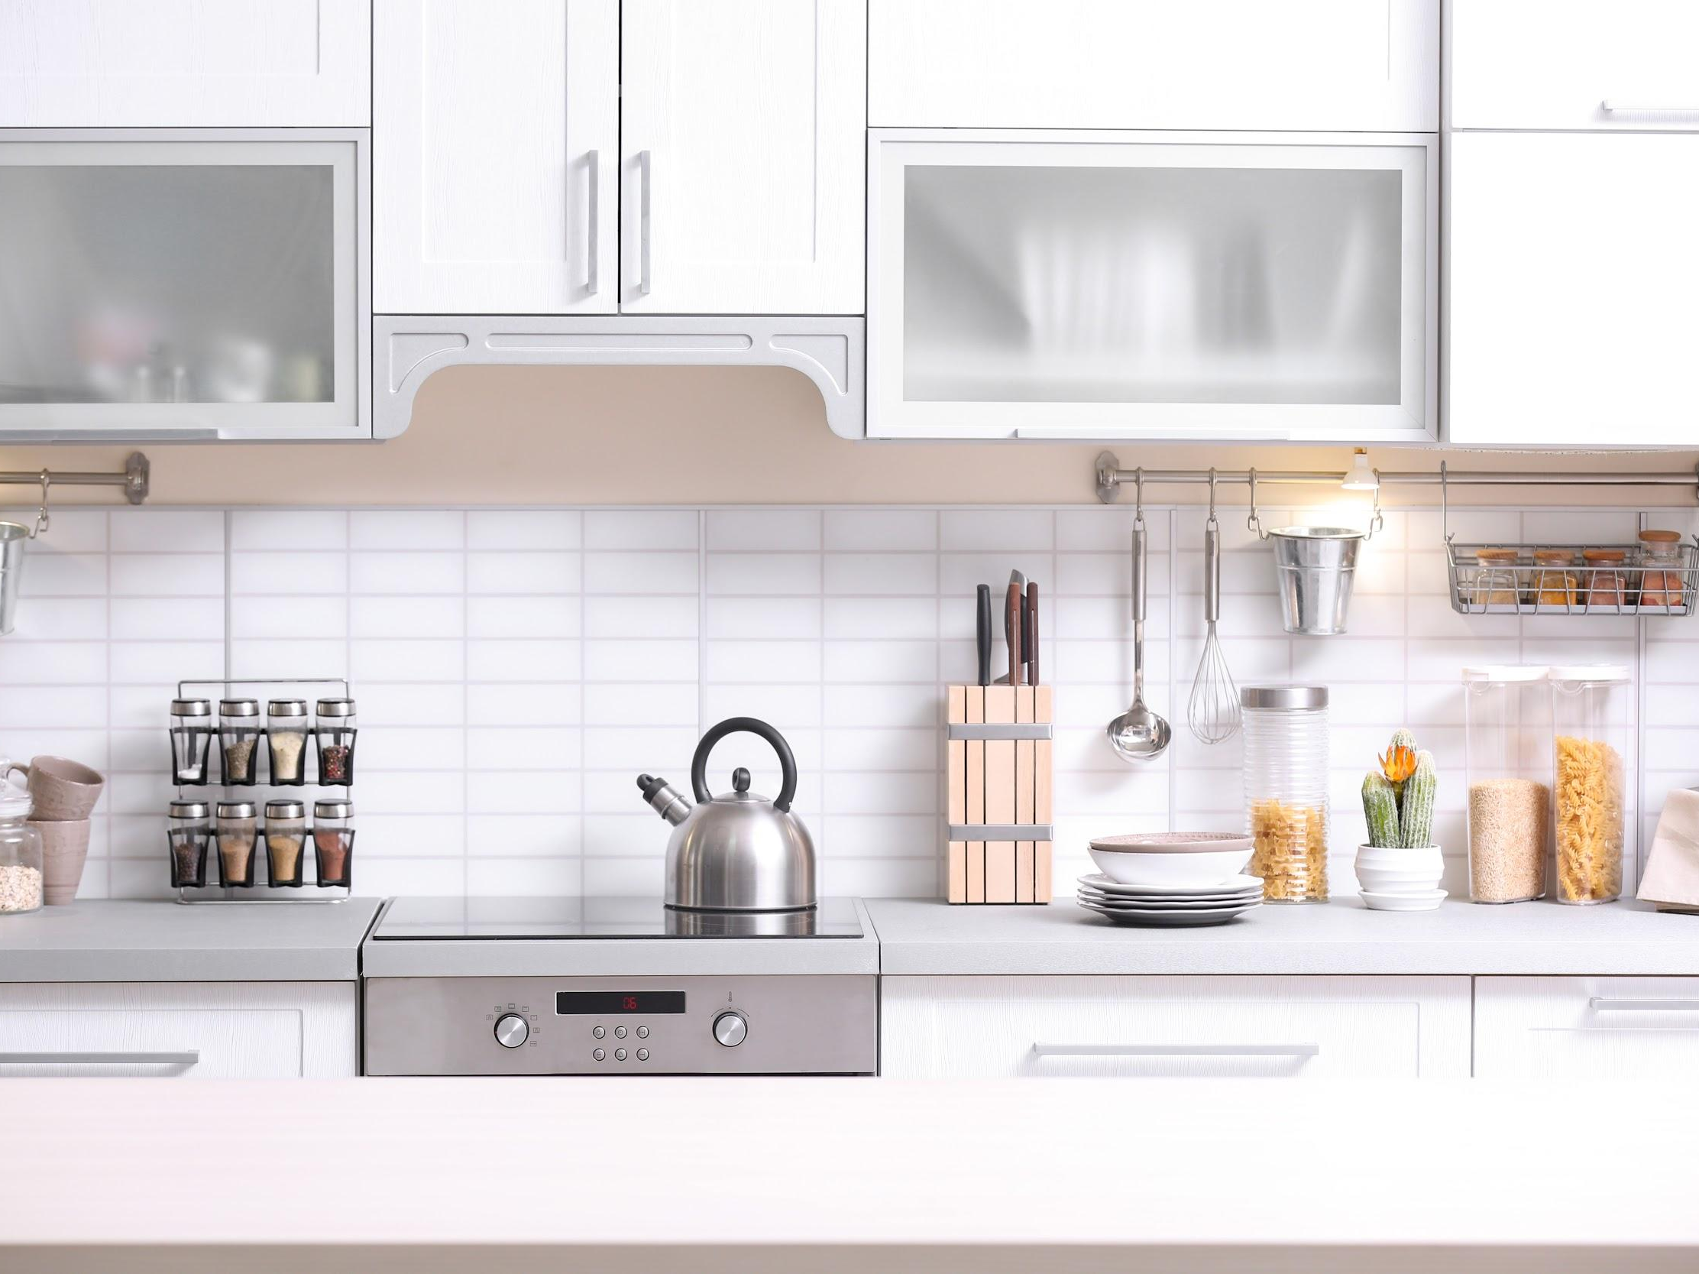
02
MARKET
ANALYSIS
One of the most important tasks to complete before selling your home is to establish a competitive price. This is done by running a comparative market analysis (CMA).
What is a CMA?
A CMA is a detailed report on homes recently sold in your area, which includes information such as home size, age, condition, location, price, and other factors that can help you set the most realistic price for your home.

Slide 8
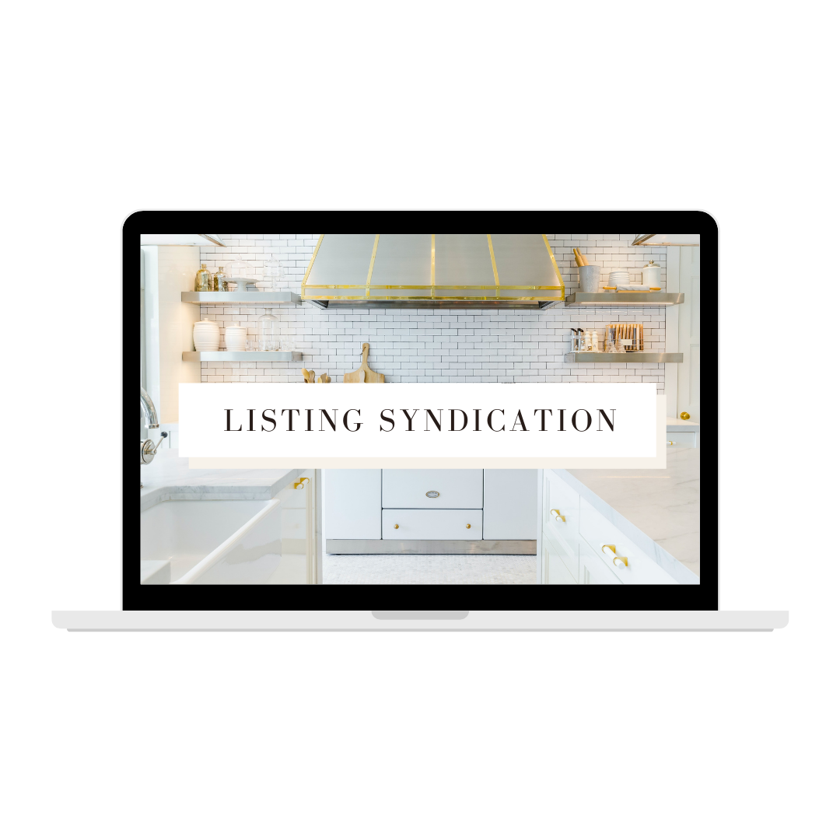
03
LISTING
SYNDICATION
Listing syndication is a process in which your listing is marketed on multiple real estate platforms to increase your home’s exposure and reduce the amount of time it takes to sell.
VARIOUS POTENTIAL
SYNDICATION PLATFORMS
Zillow.com
Homes.com
Realtor.com
HomeSeekers.com
Vast
Realtytrac
Homepath
Apartments.com
Homes & Land

Slide 9
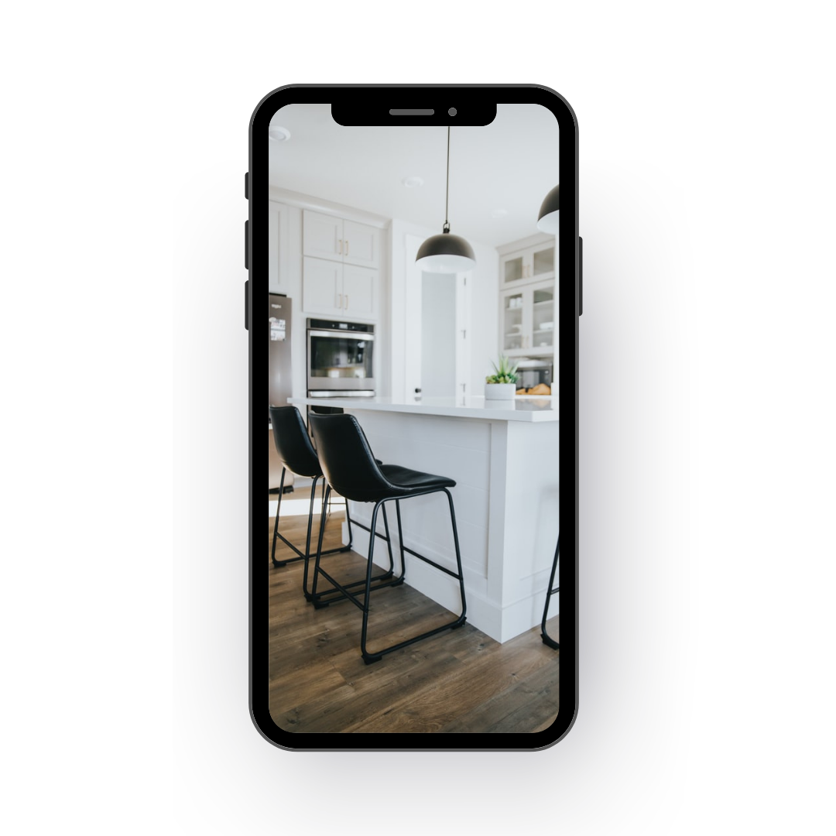
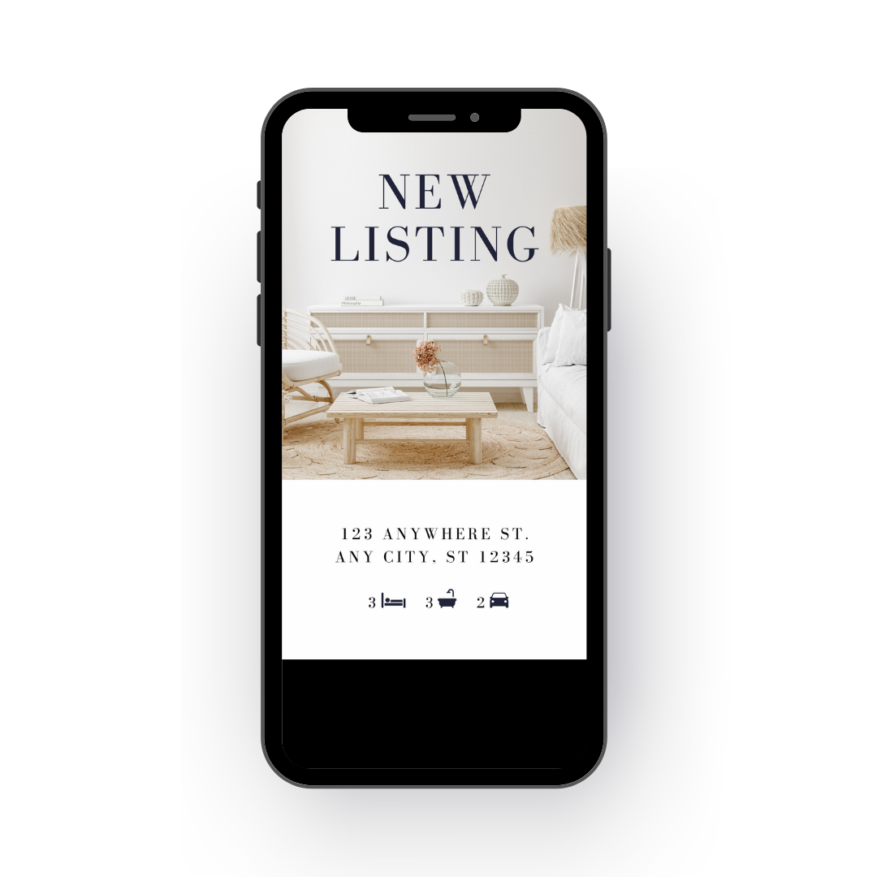
While we follow traditional marketing protocols, we’ll also implement the latest social media strategies to ensure your home receives maximum exposure. A modern strategy combined with striking images and videos of your listing guarantees that your home will stay ahead of the competition.
Ad campaigns
Social media shares
Strategic and timely posts
Listing videos
Blog posts
04
SOCIAL MEDIA
STRATEGY

Slide 10
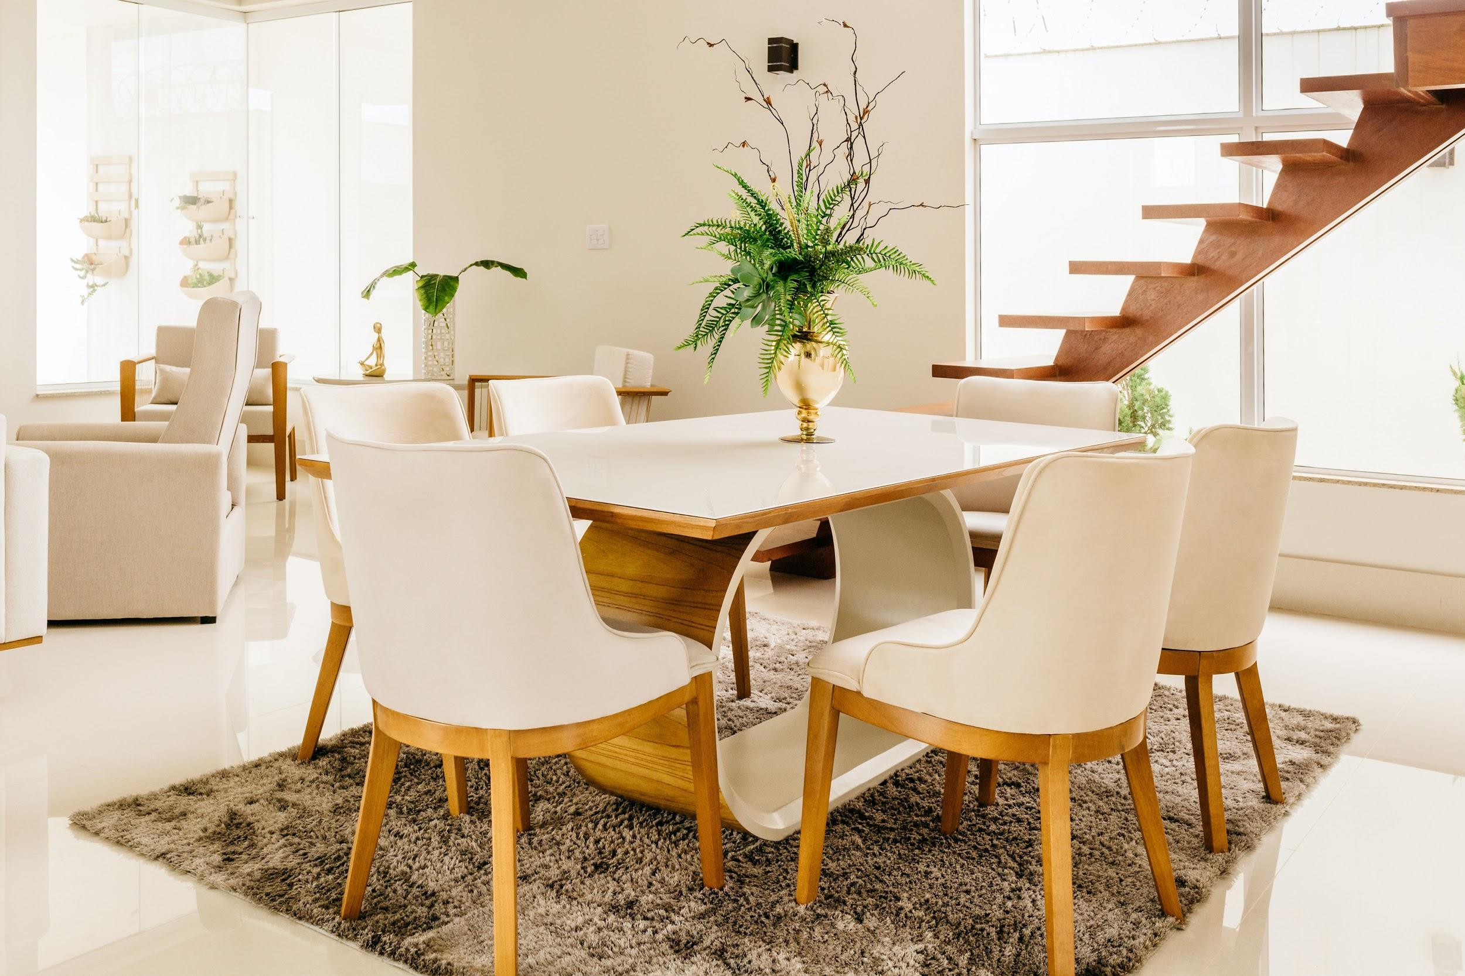
05
Print Marketing
01
02
03
CUSTOM PROPERTY FLYERS
POSTCARD
CAMPAIGN
DOOR
HANGERS

Slide 11
Scheduling
Auto-scheduling software allows buyer’s agents the opportunity to schedule showing appointments efficiently. All we have to do is set up the initial automation, input some data, and the software will take care of the rest. By using automated scheduling, we can ensure all parties are notified of the appointment request immediately and get showings confirmed quickly.
06

Slide 12
FEEDBACK
Receiving buyer feedback on your listing is key when crafting an effective marketing plan. In the feedback process, we can determine how buyers are evaluating the worth of your home and adjust showings as needed to get the best outcome for your sale.

Slide 13
Open Houses
Photos are powerful when it comes to selling a home, but nothing compares to seeing it in person. That's why hosting stellar open house experiences are crucial for your success as a seller.
Tips to Prepare
07
Freshen up faded and chipped paint
Declutter and depersonalize
Update your curb appeal
Deep clean
Craft a marketing plan
Perform an odor test

Slide 14
Contract
Negotiation.
01
Review the agreement
02
Review contingencies
03
Establish your priorities
04
08
Decide on counteroffer, acceptance or rejection
05
Obtain signatures from all parties

Slide 15
STAGING TIPS
PREPARE YOUR HOME
Declutter & depersonalize
Minimize furniture
Create a neutral space that buyers can envision themselves in.
Deep clean
Use natural lighting
Eliminate odors
Have a fresh set of eyes review
your home
Creating a warm and inviting space makes a home more attractive to potential buyers.

Slide 16
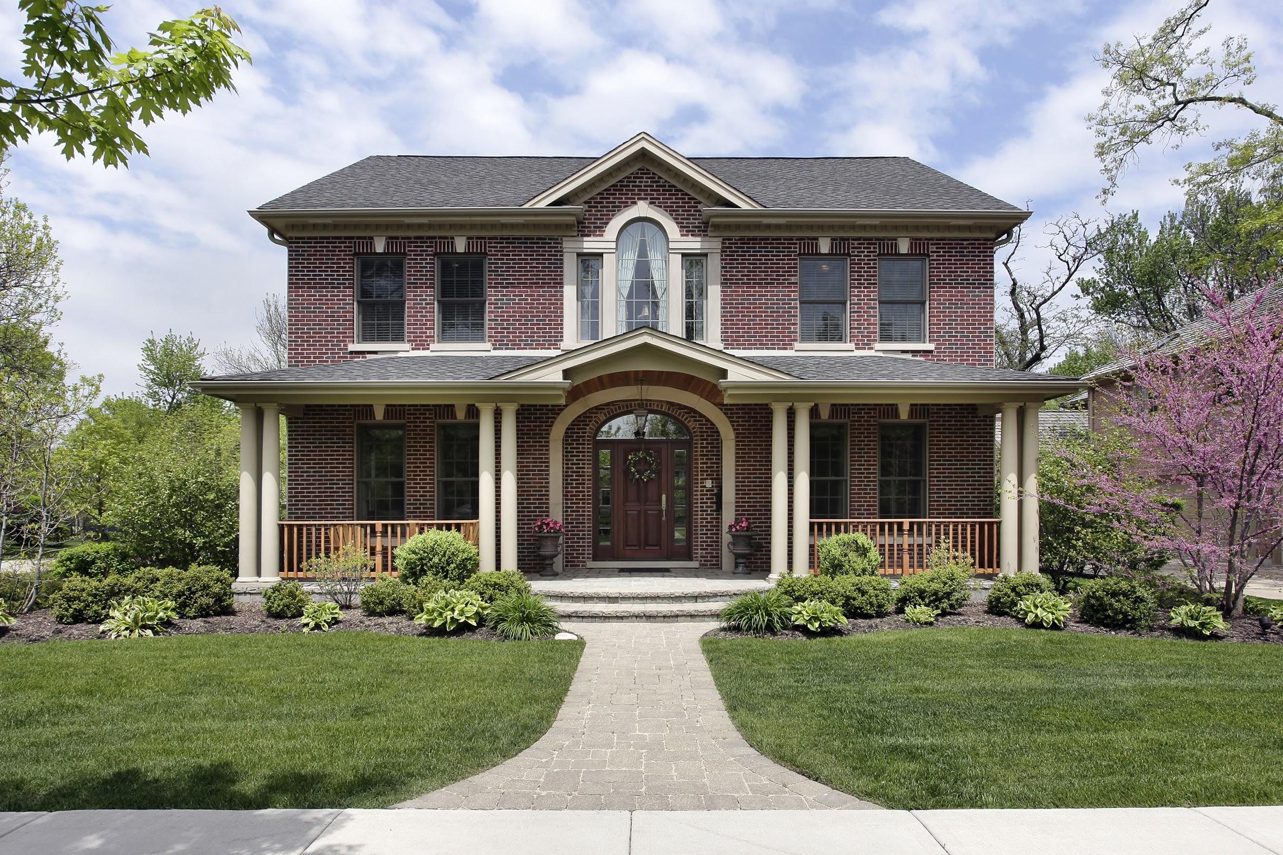
STAGING TIPS
CURB APPEAL
Pull out weeds
Pressure wash the sidewalks
Avoid overcrowding your front yard.
Use seasonal decor
Clean or install new hardware
Fill cracks in the pavement
Decorate in a way that allows the buyer to imagine themselves using the spaces.
Clean up and trim the lawn

Slide 17
Thank you.
Kimberly Dixon Dudley
REAL ESTATE BROKER
5151 Katy Fwy #210 Hou,Tx 77007 | 713-357-1616 | KIM@KLPTX.COM

